Slide 1

Green Pace
Security Policy Presentation
Developer: Aparna Pyneni

Slide 2

OVERVIEW: DEFENSE IN DEPTH
Security policy consists of security principles, coding standards, authentication, authorization and multi layer security standards etc. It helps maintain consistent security approach across all applications. The multi layered approach provides multiple, redundant defensive measures in case a security control is exploited.

Slide 3
THREATS MATRIX
Likely Memory Protection threats are likely to occur due to accessing an element outside of array range. | Priority SQL Injection threats should be treated as high priority and fixed immediately.
Low priority Checking the string to number conversions and checking data errors. It causes an inaccurate result but not threat. | Unlikely Assertions are a valuable diagnostic tool for finding and eliminating software defects that may result in vulnerabilities.

Slide 4
10 PRINCIPLES
S. No | Principle | Coding Standard
1 | Validate Input Data | Data Type: Do not pass a nonstandard-layout type object across execution boundaries.
2 | Heed Compiler Warnings | Integers: Do not cast to an out-of-range enumeration value.
3 | Architect and Design for Security Policies | Exceptions: Handle all exceptions
4 | Keep It Simple | Containers: Use valid iterator ranges
5 | Default Deny | Memory Protection: Do not access freed memory
6 | Adhere to the Principle of Least Privilege | Authorization: Verify the permissions before granting access
7 | Sanitize Data Sent to Other Systems | SQL Injection: SQL injection vulnerabilities arise in applications where elements of a SQL query originate from an untrusted source.
8 | Practice Defense in Depth | String Correctness: Detect errors when converting a string to a number.
9 | Use Effective Quality Assurance Techniques | Assertions: Use a static assertion to test the value of a constant expression
10 | Adopt a Secure Coding Standard | File Input Output: Reset strings on fgets() or fgetws() failure

Slide 5
CODING STANDARDS
Vulnerabilities are categorized into High, Medium and low. Please find the associated vulnerability category in case a coding standard is violated.
S. No | Coding Standard | Vulnerability Severity if broken
1 | Data Type: Do not pass a nonstandard-layout type object across execution boundaries. | High
2 | Integers: Do not cast to an out-of-range enumeration value. | Medium
3 | Exceptions: Handle all exceptions | Medium
4 | Containers: Use valid iterator ranges | High
5 | Memory Protection: Do not access freed memory | High
6 | Authorization: Verify the permissions before granting access | Low
7 | SQL Injection: SQL injection vulnerabilities arise in applications where elements of a SQL query originate from an untrusted source. | Medium
8 | String Correctness: Detect errors when converting a string to a number. | High
9 | Assertions: Use a static assertion to test the value of a constant expression | Medium
10 | File Input Output: Reset strings on fgets() or fgetws() failure | Medium

Slide 6
ENCRYPTION POLICIES
Encryption | It is one of the key aspects of the IT security. Without, encryption, sensitive business information would be vulnerable to anyone who could steal or interpret it. Data can be encrypted in one of the three states: at rest, in use and in transit.
Encryption in rest | Protects your data where it’s stored—on your computer, in your phone, on your data database, or in the cloud. For example, you saved a copy of a paid invoice on your server with a customer’s credit card information. You definitely don’t want that to fall into the wrong hands. By encrypting data at rest, you’re essentially converting your customer’s sensitive data into another form of data. This usually happens through an algorithm that can’t be understood by a user who does not have an encryption key to decode it. Only authorized personnel will have access to these files, thus ensuring that your data stays secure
Encryption at flight | Protects your data as it moves from one location to another, as when you send an email, browse the Internet, or upload documents to the cloud. For example, an app on a mobile phone connects to a banking service to request a transaction. Such data is typically encrypted using protocols such as HTTPs.
Encryption in use | Protects your data when it is opened by one or more applications for its treatment or and consumed or accessed by users. Normally, behind the application there is a user who wants to access the data to view it, change it, etc. In this state, the data is more vulnerable, in the sense that in order to see it, the user must have been able to access the content decrypted (in the case that it was encrypted).

Slide 7
TRIPLE-A POLICIES
Triple-A Framework | Explain what it is and how and why the policy applies.
Authentication | Authentication refers to unique identifying information from each system user, generally in the form of a username and password. System administrators monitor and add or delete authorized users from the system.
Authorization | Authorization refers to the process of adding or denying individual user access to a computer network and its resources. Users may be given different authorization levels that limit their access to the network and associated resources. Authorization determination may be based on geographical location restrictions, date or time-of-day restrictions, frequency of logins or multiple logins by single individuals or entities. Other associated types of authorization service include route assignments, IP address filtering, bandwidth traffic management and encryption.
Accounting | Accounting refers to the record-keeping and tracking of user activities on a computer network. For a given time period this may include, but is not limited to, real-time accounting of time spent accessing the network, the network services employed or accessed, capacity and trend analysis, network cost allocations, billing data, login data for user authentication and authorization, and the data or data amount accessed or transferred.

Slide 8
Unit Testing
Vulnerability planned to be tested is “throwing an exception when trying access an element outside of range in the collection”
// Try accessing an element outside of the size.
TEST_F(CollectionTest, IsNegativeTest)
{
add_entries(10);
ASSERT_THROW(collection->at(10), std::out_of_range);
}
More unit test examples can be found in the attached *.CPP file and unit test results summary can be in the attached document

Slide 9

AUTOMATION SUMMARY

Slide 10
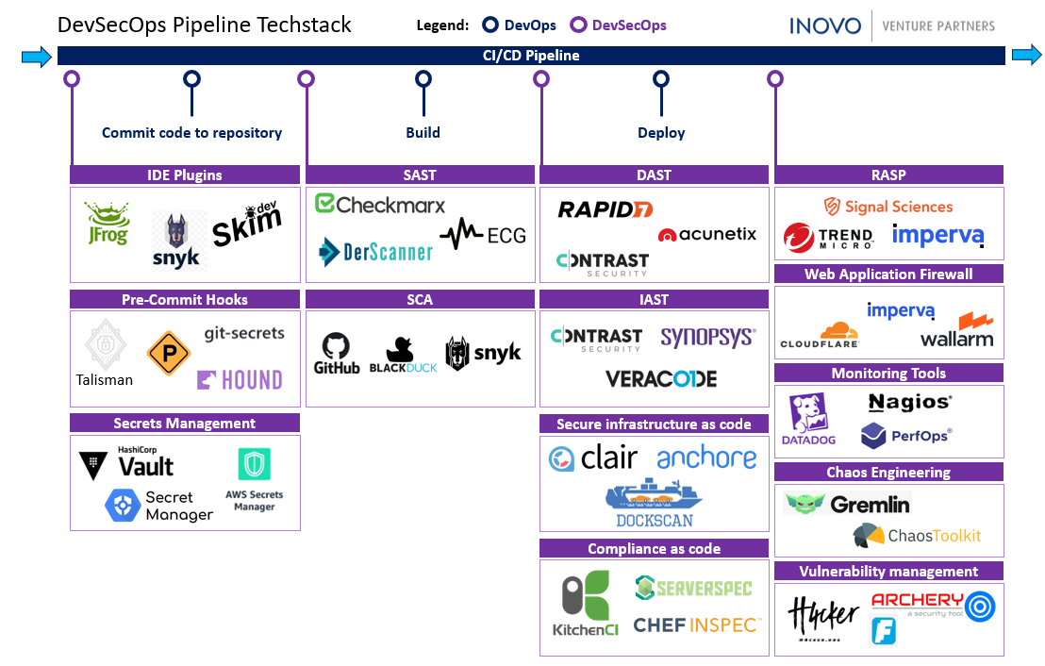
TOOLS
DevSecOps is a mindset or a culture that developers and IT operations teams follow while developing and deploying software applications. It integrates active and automated security audits and penetration testing into agile application development.

Slide 11
RISKS AND BENEFITS
Security policies should govern the practices used by organizations with regard to protecting their physical and information technology assets. Not having or following a poor security policy would lead to following issues.
Assaults and Vandalism
Theft of Goods
Electronic Theft
Corporate Espionage
Loss of Access
Legal Liability
Data Theft
Cancellation of license to do business
Loss of consumer trust

Slide 12
RECOMMENDATIONS
Green Pace policy can be further enhanced and following are some of the common gaps noticed.
Open Ports A port is a communication point for a server that allows an external service or program to pass through data or perform an action based on the specific port’s function. While having a port that is open for communication is not always a potential risk, dangerous or vulnerable software can be hosted through an open port so it’s important to be restrictive about what is left open. Sometimes, ports are left open and then forgotten about, or opened without the knowledge of IT. These can present a vulnerability.
End-Of-Life Software is simply a software program or service that is no longer updated and/or supported by its producer. This software lifecycle stage often also means that there will be no future security updates or patches, leaving the software and its underlying services vulnerable to breach as cyber attackers become more sophisticated.
Email Authentication is a technical means of verifying that the sender of an email is who they claim to be. The value of having this enabled through your email provider can not be understated as phishing attempts are on the rise (in 2018, 83% of people received phishing attacks worldwide) and are considered to be the most common of all cyber attack methods.

Slide 13
CONCLUSIONS
Following are the standards should be adopted for future
Cloud security: With increase cloud foot print, it could become an attractive target for hackers. All public, private and hybrid cloud services should be protected with latest security standards.
Multi factor authentication: User authentication and financial transactions should be protected with additional authentication procedures like sending a one time passcode.
Biometric authentication: It refers to security processes that verify a user's identity through unique biological traits such as retinas, irises, voices, facial characteristics, and fingerprints. FaceId and TouchId are the examples.
Update security policy frequently: Security policy must updated frequently to latest vulnerabilities.

Slide 14
REFERENCES
https://medium.com/inside-inovo/devsecops-explained-venture-capital-perspective-cb5593c85b4e
https://www.techopedia.com/definition/24130/authentication-authorization-and-accounting-aaa
https://smallbusiness.chron.com/keep-data-safe-42160.html
https://www.corvusinsurance.com/blog/most-common-security-gaps
https://wiki.sei.cmu.edu/confluence/pages/viewpage.action?pageId=88046682
https://www.linkedin.com/pulse/understanding-hierarchy-principles-policies-standards-wally-beddoe/

